Slide 1

ET 8304 microprocessor and interfacing
MBEYA UNIVERSITY OF SCIENCE AN TECHNOLOGY
OCTOBER 2022
LECT 2

Slide 2
INTERNAL STRUCTURE AND BASIC OPERATION OF MICROPROCESSOR
ALU
Register Section
Address bus
Data bus
Control and timing section
Control bus
Block diagram of a microprocessor

Slide 3
ARITHMETIC AND LOGIC UNIT (ALU)
The component that performs the arithmetic and logical operations
the most important components in a microprocessor, and is typically the part of the processor that is designed first.
able to perform the basic logical operations (AND, OR), including the addition operation.

Slide 4
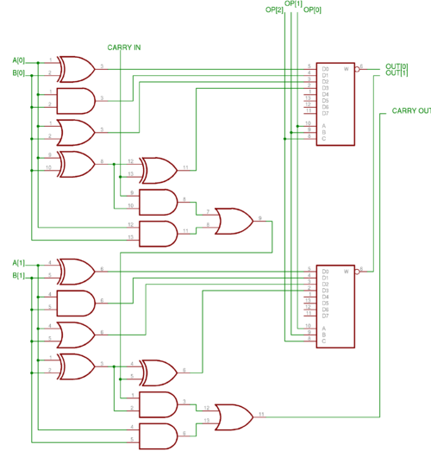
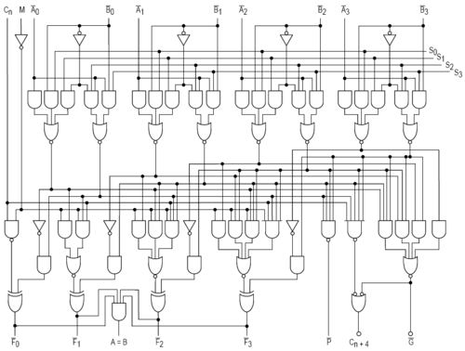
INTERNAL STRUCTURE OF ALU
2 bits of ALU
4 bits of ALU

Slide 5
CONTROL UNIT
The circuitry that controls the flow of information through the processor, and coordinates the activities of the other units within it.
In a way, it is the "brain within the brain", as it controls what happens inside the processor, which in turn controls the rest of the PC.
On a regular processor, the control unit performs the tasks of fetching, decoding, managing execution and then storing results.

Slide 6
REGISTER SETS
The register section/array consists completely of circuitry used to temporarily store data or program codes until they are sent to the ALU or to the control section or to memory.
The number of registers are different for any particular CPU and the more register a CPU have will result in easier programming tasks.
Registers are normally measured by the number of bits they can hold, for example, an "8-bit register" or a "32-bit register".

Slide 7
REGISTER IN MOTOROLA 68000 MICROPROCESSOR
31 16 15 8 7 0
D0
D1
D2
D3
D4
D5
DATA REGISTERS
D6
D7
31 16 15 8 7 0
A0
A1
A2
A3
A4
A5
ADDRESS REGISTERS
A6
A7
USER STACK POINTER
A7
STACK POINTER
SUPERVISOR STACK POINTER
PC
PROGRAM CONTER
15 8 7 0
SYSTEM BYTE
USER VYTE
SR
STATUS REGISTER

Slide 8
ACCUMULATOR
a register in which intermediate arithmetic and logic results are stored.
example for accumulator use is summing a list of numbers.
The accumulator is initially set to zero, then each number in turn is added to the value in the accumulator.
Only when all numbers have been added is the result held in the accumulator written to main memory or to another, non-accumulator, CPU register.

Slide 9
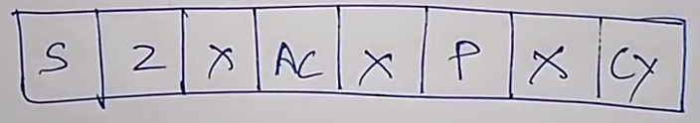
CONDITION CODE REGISTER (CCR) = FLAGS
an 8 bit register used to store the status of CPU, such as carry, zero, overflow and half carry.

Slide 10
PROGRAM COUNTER (PC)
a 16 bit register, used to store the next address of the operation code to be fetched by the CPU.
Not much use in programming, but as an indicator to user only.
Purpose of PC in a Microprocessor
to store address of tos (top of stack)
to store address of next instruction to be executed.
count the number of instructions.

Slide 11
STACK POINTER (SP)
The stack is configured as a data structure that grows downward from high memory to low memory.
At any given time, the SP holds the 16-bit address of the next free location in the stack.
The stack acts like any other stack when there is a subroutine call or on an interrupt. ie. pushing the return address on a jump, and retrieving it after the operation is complete to come back to its original location.

Slide 12
DATA BUS
The data bus is 'bi-directional'
data or instruction codes from memory or input/output. are transferred into the microprocessor
the result of an operation or computation is sent out from the microprocessor to the memory or input/output.
Depending on the particular microprocessor, the data bus can handle 8 bit or 16 bit data.

Slide 13
ADDRESS BUS
The address bus is 'unidirectional', over which the microprocessor sends an address code to the memory or input/output.
The size (width) of the address bus is specified by the number of bits it can handle.
The more bits there are in the address bus, the more memory locations a microprocessor can access.
A 16 bit address bus is capable of addressing 65,536 (64K) addresses.

Slide 14
CONTROL BUS
The control bus is used by the microprocessor to send out or receive timing and control signals in order to coordinate and regulate its operation and to communicate with other devices, i.e. memory or input/output.

Slide 15
MICRO PROCESSOR CLOCK
Also called clock rate, the speed at which a microprocessor executes instructions. Every computer contains an internal clock that regulates the rate at which instructions are executed and synchronizes all the various computer components.

Slide 16
EXAMPLES OF MICRO PROCESSOR
Intel 8086
Motorola 6800
Zilog Z80

Slide 17
8085 Microprocessor
Introduction
Overview of 8085 microprocessor
8085 Architecture
Pin Diagram
Functional Block Diagram

Slide 18
Introduction
The technological revolution brought the invention of micro-programmable computer on microprocessor chip
First four bit microprocessor chip
INTEL-4004 was developed by Intel Corporation of America in 1971.
Intel introduced in 1972 an 8-bit microprocessor 8008 and in 1973 another 8-bit microprocessor 8080. The microprocessor 8080 was the most popular microprocessor of the early 70s. In the year 1974, Intel developed a 40 pin microprocessor chip 8085, which was the enhanced version of 8080.
Intel 8080 microprocessor was not in fact a complete CPU on a chip because the clock and controller were on separate chip. Further, it utilizes two separate power supplies. The 8085 microprocessor has the advantages over 8080 that it has on-chip clock and control circuit. It needs only one power supply of +5 volts.

Slide 19
ARCHITECTURE OF 8085 MICROPROCESSOR
Intel 8085, an 8-bit microprocessor is available in the form of 40 Pin dual in line IC package. It is fabricated on a single LSI chip. It operates on +5 V d.c. supply.
The clock speed used in this microprocessor is about 3 MHZ.
General Purpose 8-bit microprocessor is capable of addressing up to 64 K bytes (i.e. 2^16= 655362 bytes) of memory.

Slide 20
main functional components of 8085A microprocessor
Register Section
Arithmetic and Logic Unit
Timing and Control Section
Interrupt Control
Serial Input / Output Control

Slide 21
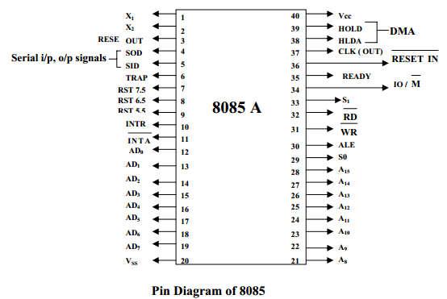
Pin Diagram 8085 microprocessor

Slide 22
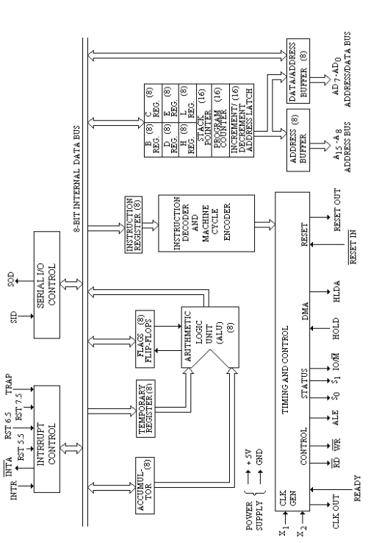
8085 Architecture

